Slide 1
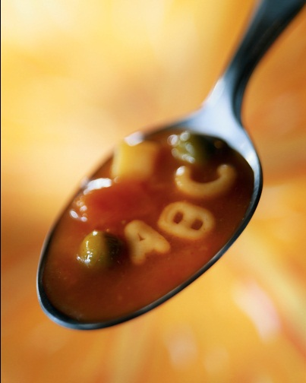
Sentence Soup
Adding Variety to Writing

Slide 2
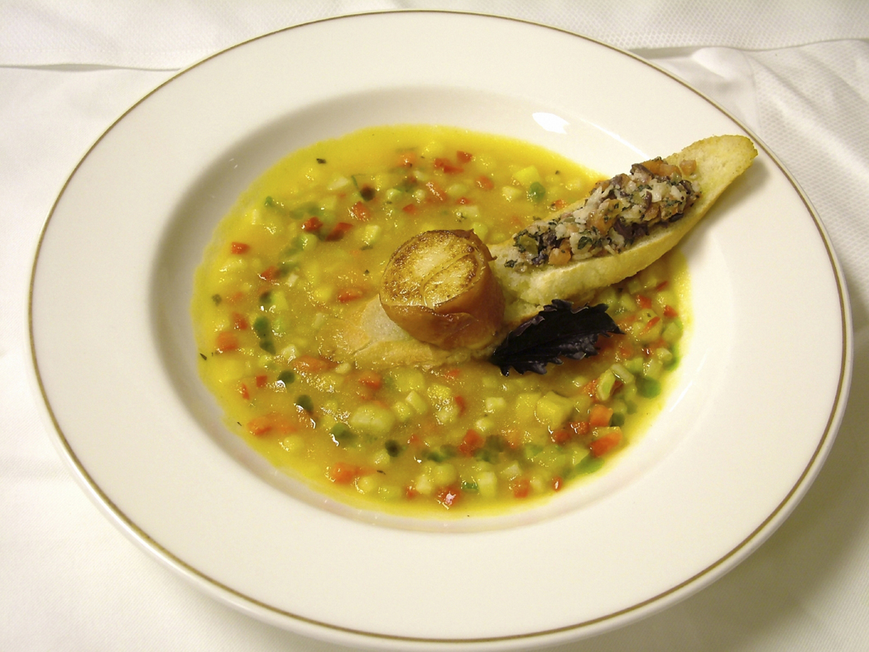
What is in a good soup?

Slide 3
Too much of a good thing?

Slide 4
Sentence Variety
Sentence Length: Mix up longer sentences and shorter ones.
Describing words: Use them, but don’t put too much. (These are like the spices in your soup)
Types of sentences: Mix up the word order in your sentences
Using strong verbs and not weak ones.
Using the perfect punctuation.

Slide 5
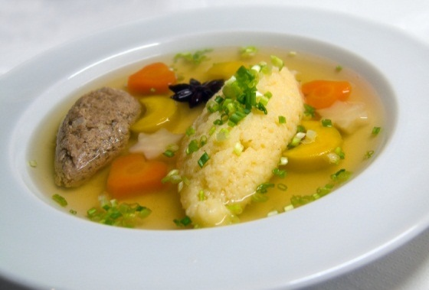
Help Fix this Soup!
The dark clouds hovered over the castle and suddenly a dragon burst through and spit fire at the tower. All the knights rushed to help fight the dragon, but none of them could harm it with their swords.

Slide 6
Help Fix this Soup!
2. The beautiful, muscular brown horse galloped mightily across the dry, dusty, tan desert.

Slide 7

Help Fix this Soup!
I walked to the store and then walked back.

Slide 8
Help Fix this Soup!
Why did you do that?!?! That, was, not, cool.

Slide 9
Help Fix this Soup!
Feeling bad, John gave the candy back. Smiling at John, Liz told him it was alright.

